Slide 1
Project Title : Open Source Contact Management System Front End : TURBOC++ Compiler Back End : Data File(File Handling) PREPARED BY -Ayesha Arab -Archi Saksena -Divyesh Vadher

Slide 2
Introduction to Project:
Open Source Management System is a Software Program that enable users to easily store and find Contact Information such as Name, Address, Phone No, Category etc.

Slide 3
CONTACT DETAIL:
Serial No (Numeric)
Category (String) Friend/PG/Student/Customer/Supplier
Name (String)
Gender (String)
Age (String)
Address (String)
Phone No (String)
Email Id (String)

Slide 4
MODULE DESCRIPTION
MAIN MODULE
ADD NEW CONTACT
SEARCH CONTACT
DELETE CONTACT
EDIT CONTACT
LIST OF CONTACTS
CHANGE PASSWORD
SEARCH BY SERIAL NO
SEARCH BY CATEGORY
SEARCH BY NAME
SEARCH BY PHONE NO

Slide 5
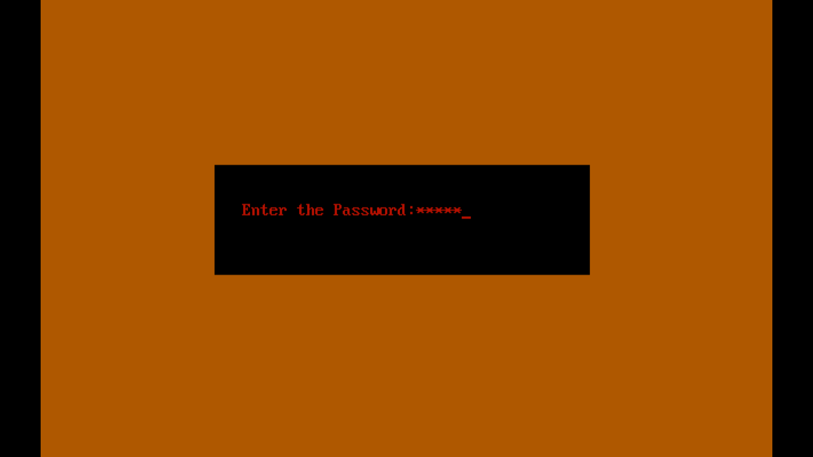
LOGIC
password.dat pass[0]
pass[1]
pass[2]
pass[3]
pass[4]
pass[5]
pass[6]
pass[7]
pass[8]
pass[9]
i
n
d
i
a
\0
\0
\0
\0
\0
india
Compare

Slide 6
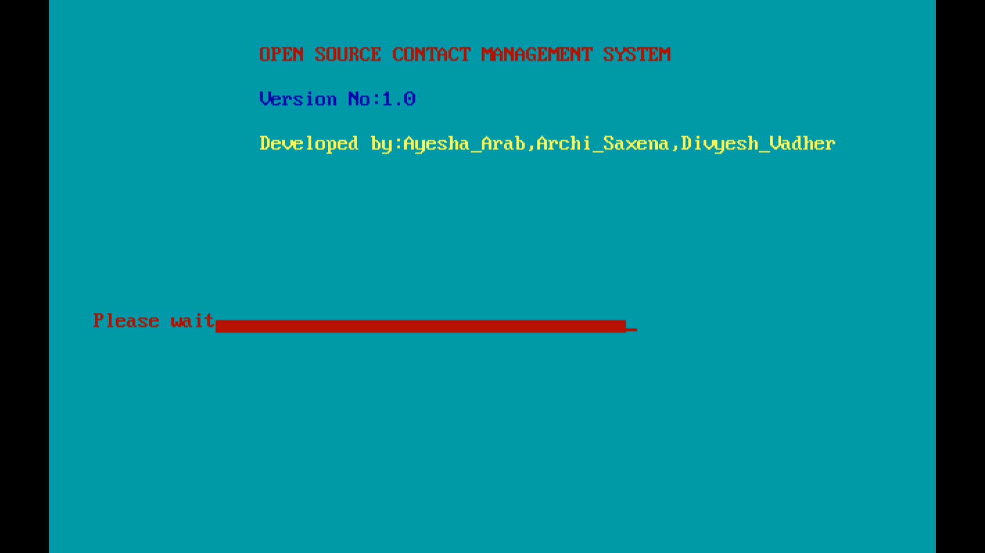
PROGRESS BAR

Slide 7
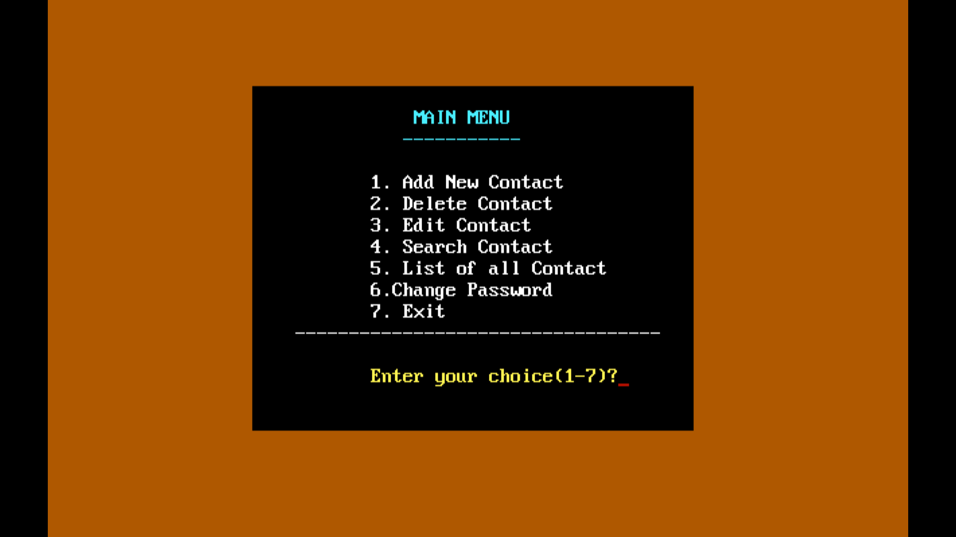

Slide 8
1. ADDING NEW CONTACT

Slide 9
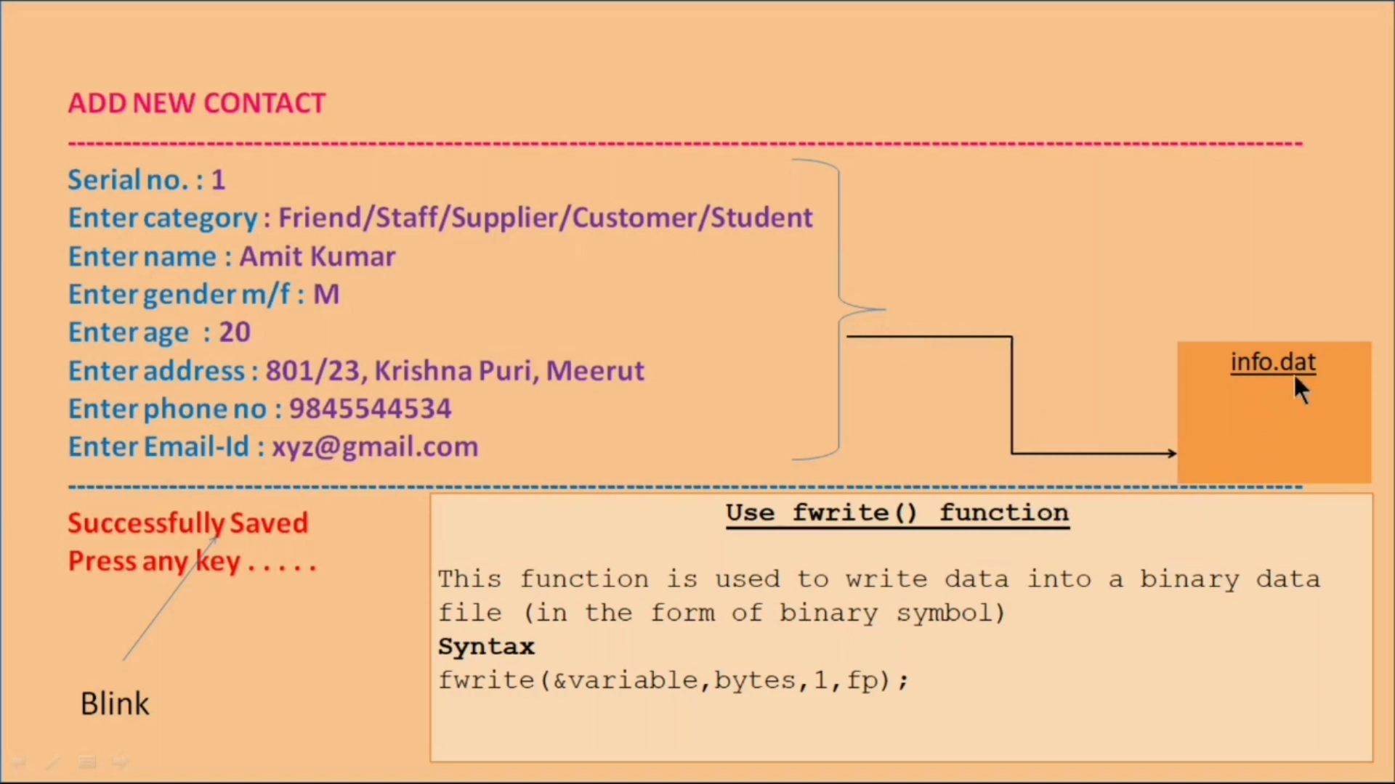

Slide 10
2.DISPLAYING THE LIST CONTACTS

Slide 11
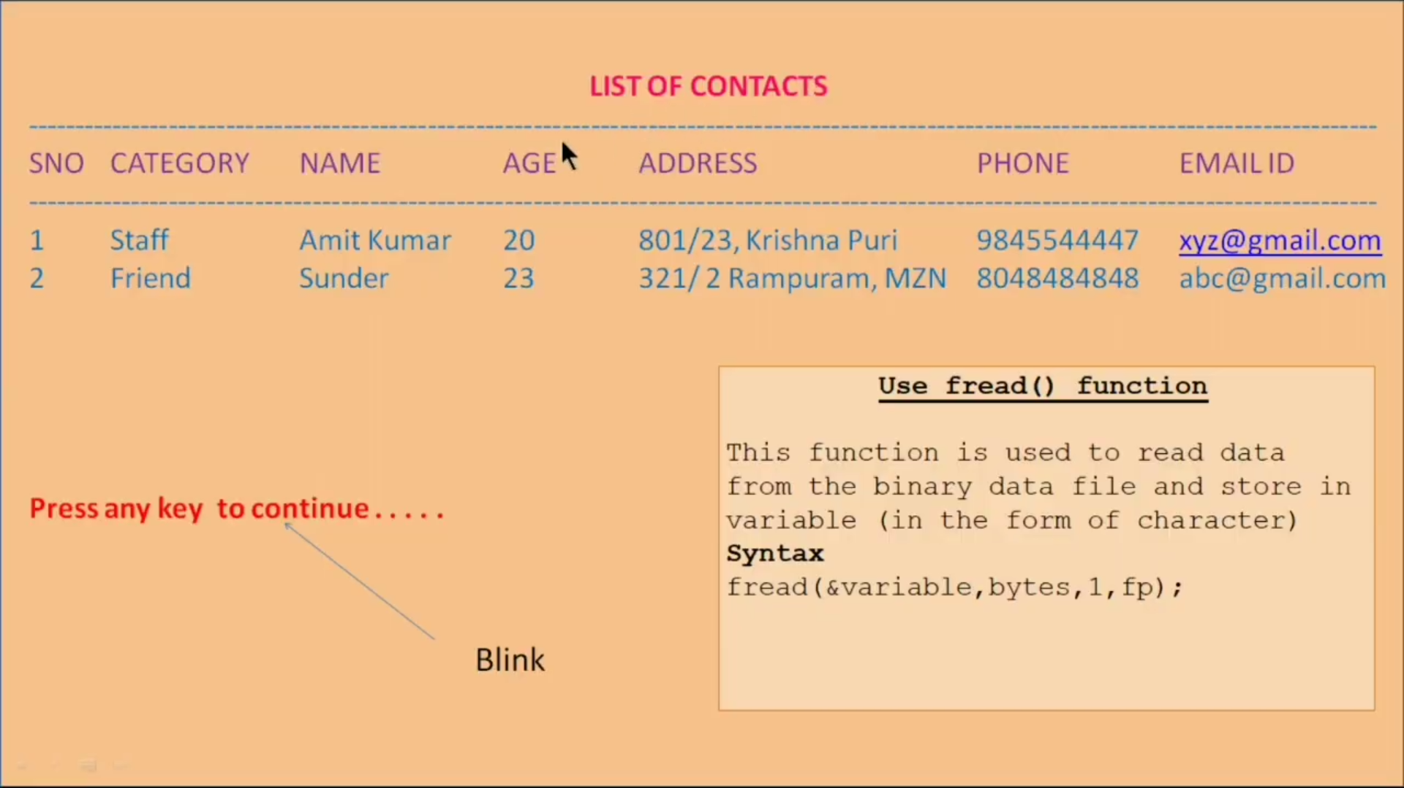

Slide 12
3.DELETING THE CONTACT

Slide 13
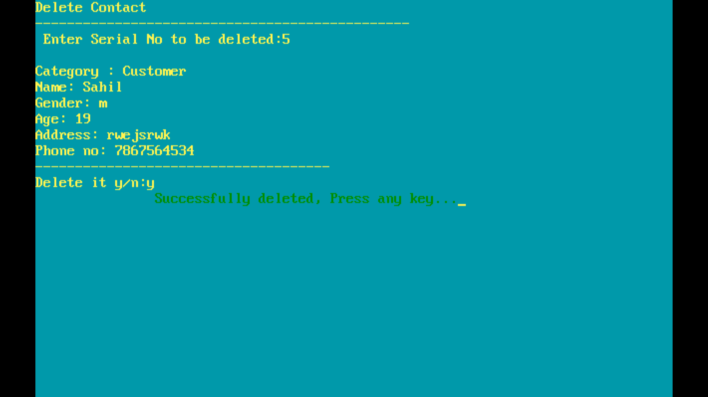

Slide 14


Slide 15
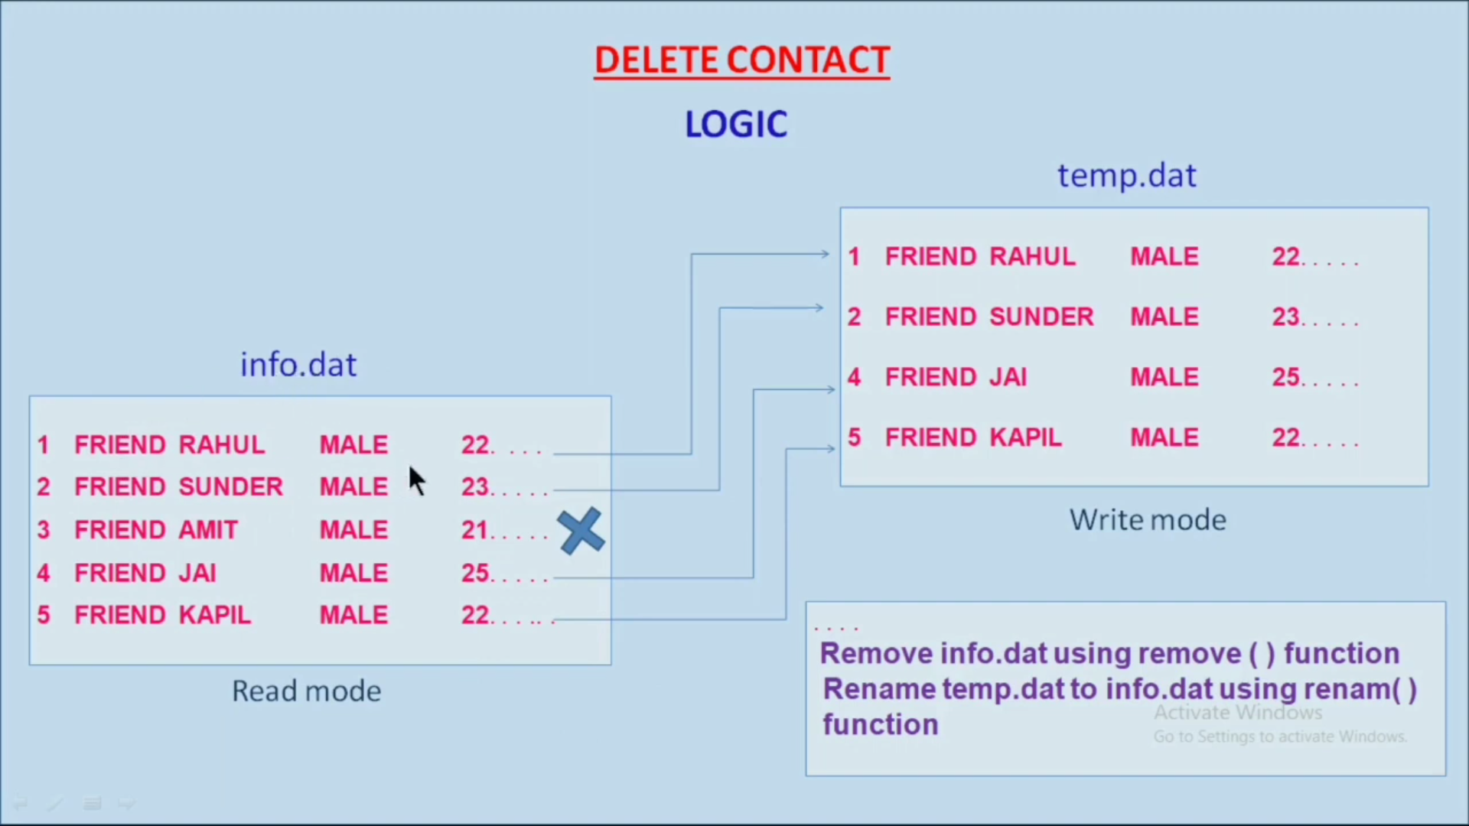

Slide 16
4.EDITING THE CONTACT

Slide 17
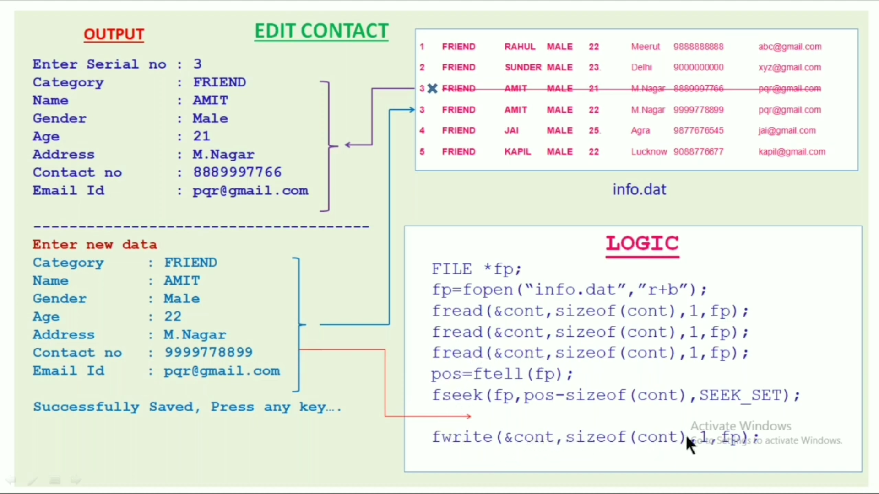

Slide 18
5.SEARCHING THE CONTACT

Slide 19
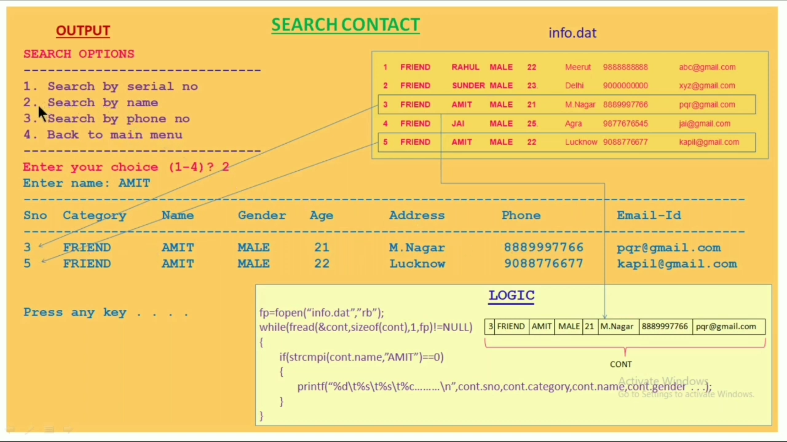

Slide 20
6.CHANGING THE PASSWORD

Slide 21
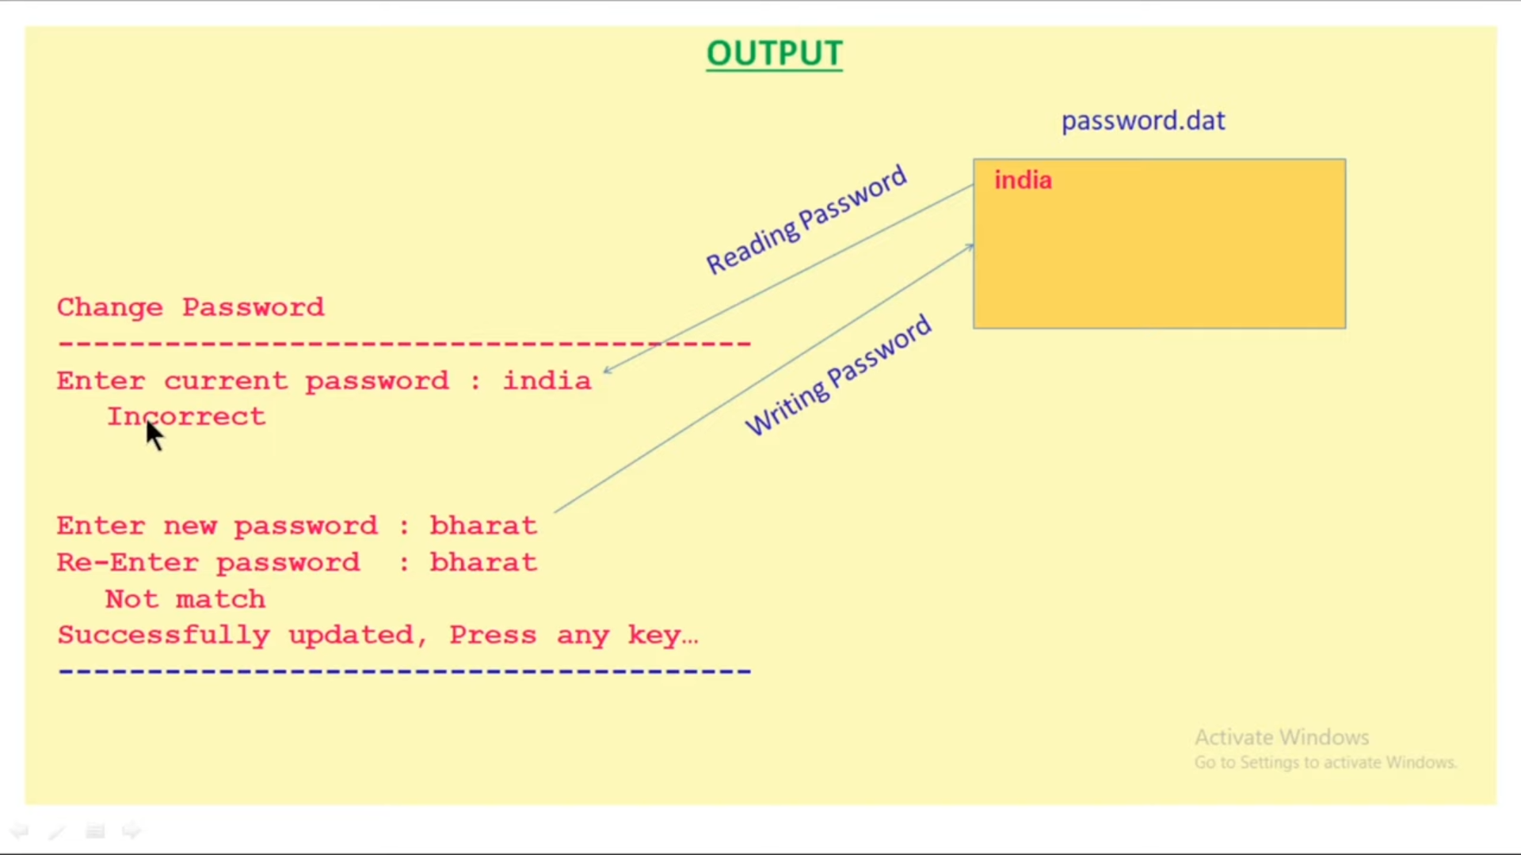

Slide 22
THANK YOU

